Slide 1
Online Food Delivery System
Group 3
Akshar Patel-0793127
Vaibhav Patel-0772934
Kush Patel-0792972
Hiren Patel-0797548
Haleem-0785982

Slide 2
PROJECT MANAGEMENT LIFE CYCLE
Initiating
Closing
Planning
Monitoring & Controlling
Executing

Slide 3
Project Initiation
Initiation process
In Covid 19, People have stopped going out for restaurants & created a great loss for them
Several customer service apps were on the rise and made quite a business
Therefore, we initiated on working a mobile app with our stakeholder/clients
Problem arise due to dull mechanism as the app face a lot of customer order traffic
Website layout was another of their requirements
Our overall outcome was to deliver the fresh order on efficient and timely response
Initiation includes:
Project Charter
Project Stakeholders

Slide 4
Stakeholders
Developers
Support Team
Testing Team
Client
Project Manager
Restaurant Owner
Responsible for developing mob-ile app & website
Supporting in issues like bug fixes at any project step
Make sure every function works at
client requirement
Approves plan and provides funds
Plans, organizes, and directs the project on time and within budget
One who wants to use entire for their business growth

Slide 5
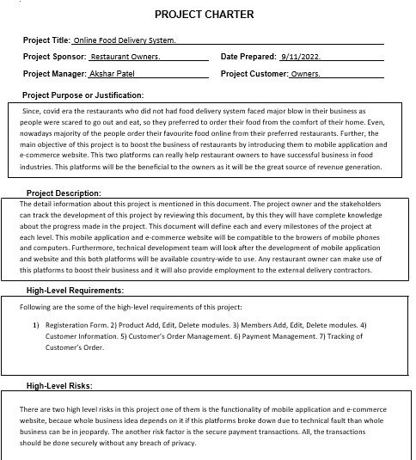
PROJECT CHARTER

Slide 6
Project Charter is giving authority to Akshar Patel as Project Manager, Hari OM Tech Co. as Project Sponsor and Customer.
It also mentions the stakeholder panel, time, expected cost, risks, and requirements.

Slide 7
The work expectations and requirements are described, and the project plan is created, whenever the project plans are archived.
It includes the project scope, cost & budget estimation, work breakdown structure, and Gantt chart as well as the project plan.
Planning

Slide 8
Project Scope
Food Ordering app can sale Food product, preferred brands, kitchen needs,
essential restaurant supplies and more, through this online, one stop Food store.
Online Food Delivery provides you with a convenient way to sale from your
Food shopping app.
This app make easy for user to buy product from store with easy steps and store
can get easy order.

Slide 9
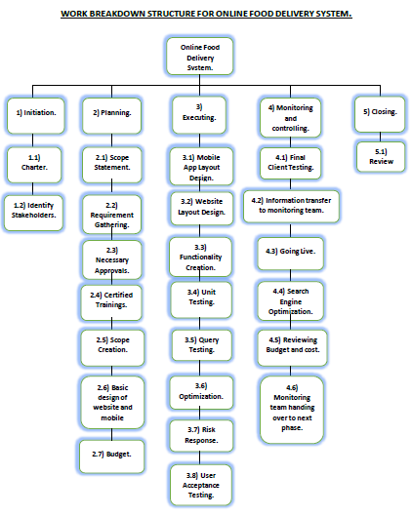
Work Breakdown Structure(WBS)
Work Breakdown Structure(WBS)

Slide 10
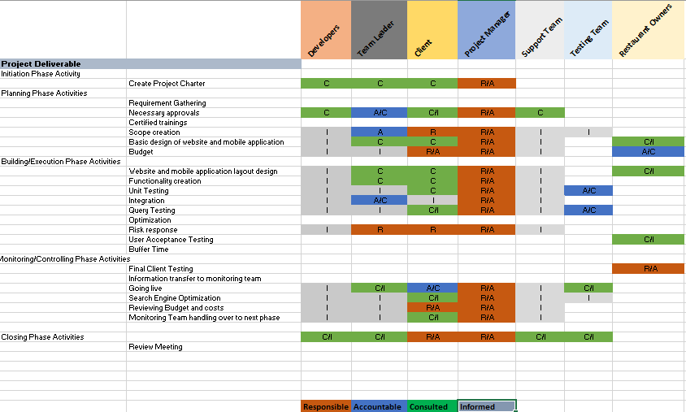
RACI Matrix
RACI Metrics

Slide 11
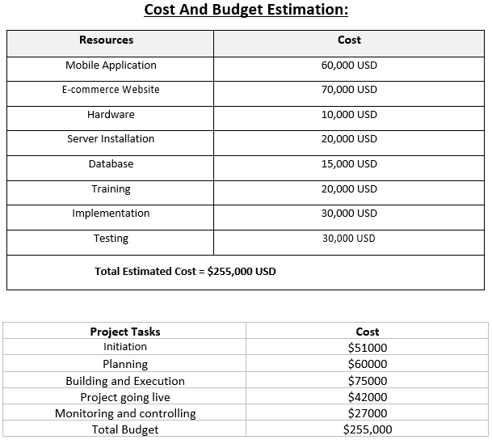

Add some text to the title slide
Project Cost & Budget

Slide 12
Mobile Application
E-commerce Website
Hardware
Server Installation
Database
Training
Implementation
Testing
60,000 USD
30,000 USD
70,000 USD
30,000 USD
Estimated Costs
10,000 USD
20,000 USD
20,000 USD
15,000 USD

Slide 13
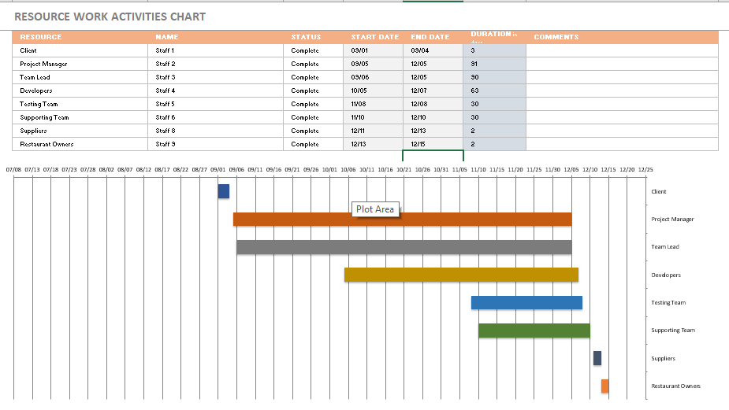
RESOURCE WORK ACTIVITIES CHART

Slide 14
Execution
Stakeholders
Developers
Team Leader / PM
Testing Team
Design a Registration Form for users
Add functions (Product Add, Edit, Delete modules)
Customer Information
Payment method
Tracking of customer’s order
Met with requirements planned in starting project with same quality.
Developed mobile app & website with great quality
Decided to make payment methods more secure for best quality
All project documents drafted were sent to concerned stakeholders upon communication
A successful communication done between us, PM, all stakeholders
Project Work
Quality
Communication

Slide 15
MONITORING & CONTROLLING
Scope
Scope is to be assure that project is going to be successful in creating mobile app & website.
Schedule
Project initiated at Oct 15
Budget
Estimated budget on scope basis
Closing is on Dec 15
Minor updates done in completion due to proposed changes of implementation
Monitoring & Controlling budget is $27000
Overall budget is $255,000
Prevention
Able to identify risks on time during development
Risks were to change website layout, mobile app & payment methods
Changes were made upon stakeholder proposals

Slide 16
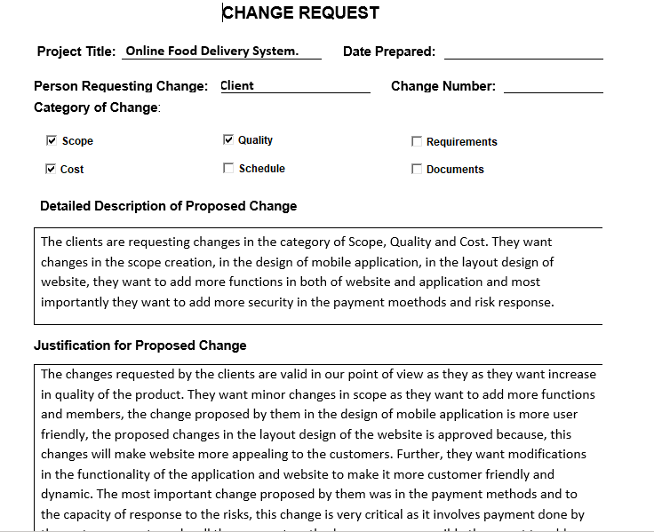
CHANGE REQUEST

Slide 17
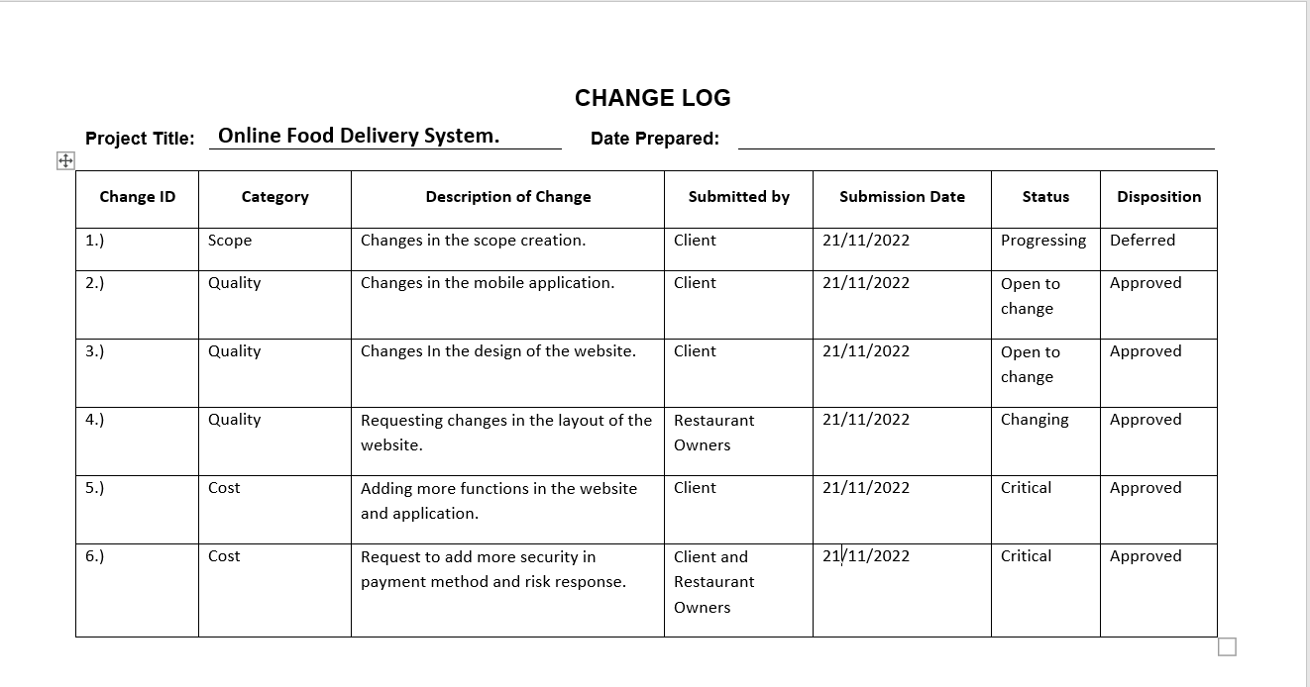
CHANGE LOG

Slide 18
Our project made progress all over in completion (mobile app. website) including functions, and additional requirements from clients
The project manager has handled greatly upon the scope, cost & budget, execution.
All the tasks required to change upon client requests have been successfully accomplished.
CLOSING

Slide 19
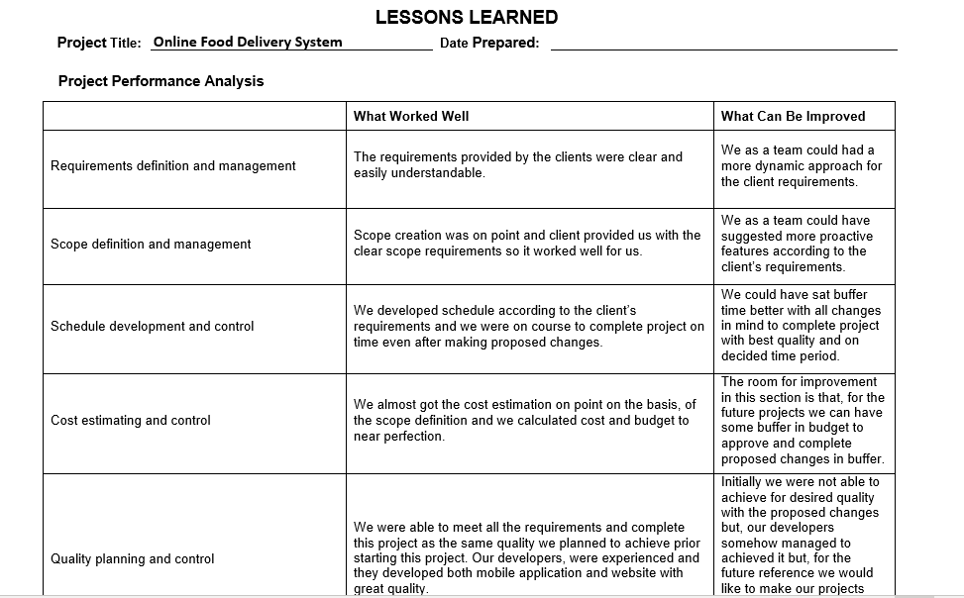
L
E
S
S O
N
S
L
E
A
R
N
E
D

Slide 20
THANK YOU

